Slide 1
Feature Selection Method using Graphical Analysis - Vishnu & Rahul

Slide 2
Outline…
Problem Statement
Existing Solutions and Limitations
Expectations from new Algorithm
Four Parameters used
ZCR Count
Separation Count
Ratio of Means
Standard Deviation of Means
Concept of Dataset Rejection
Feature Selection Algorithm Concept and Implementation
Need for Simultaneous Feature Selection and Dataset rejection
Dataset Rejection Algorithm Implementation
Dependencies
Shortcomings of the Algorithm
Results

Slide 3
Problem Statement
Given two machine states and a set of features, the objective is to recognize the best features that clearly and consistently distinguish the two states over prolonged time. In our experiments, we have generally considered healthy state of machine (normal machine state without any faults) and some particular faulty state as the two states.
Prolonged time is effectively translated to recordings taken over multiple datasets. Next slide discusses why multiple datasets are needed.

Slide 4
Data Acquisition in Cycle
Dataset -……1
After performing lot of experiments on air compressor, we observed that the air compressor over long periods of time gradually changes its acoustic characteristics, even while lying in the same state. Hence, to capture those trends in data which do not change with time, multiple cycles of recordings (also termed as datasets) are acquired over prolonged period of time.
Cycle refers to changing of machine state from State 1 to State 2 and then back to State 1. One complete cycle of recordings taken for State 1 and then State 2 is termed as one dataset.
Healthy
LIV fault
Dataset -……2
Healthy
LIV fault
Dataset -……3
Healthy
LIV fault
Dataset -……N
Healthy
LIV fault
Sample Data Acquisition Flow for detection of Healthy and LIV faults in Air compressor.

Slide 5
Feature Selection Algorithms : Limitations
Principal Component Analysis - Fails in case of non linear problems.
Mutual Information - Highly dependent on smoothing parameters.
Bhattacharyya Distance
Independent Component Analysis
With regards to performance on real-time data, PCA, MI based methods, BD and ICA did not give reliable features always (features that give consistent performance).

Slide 6
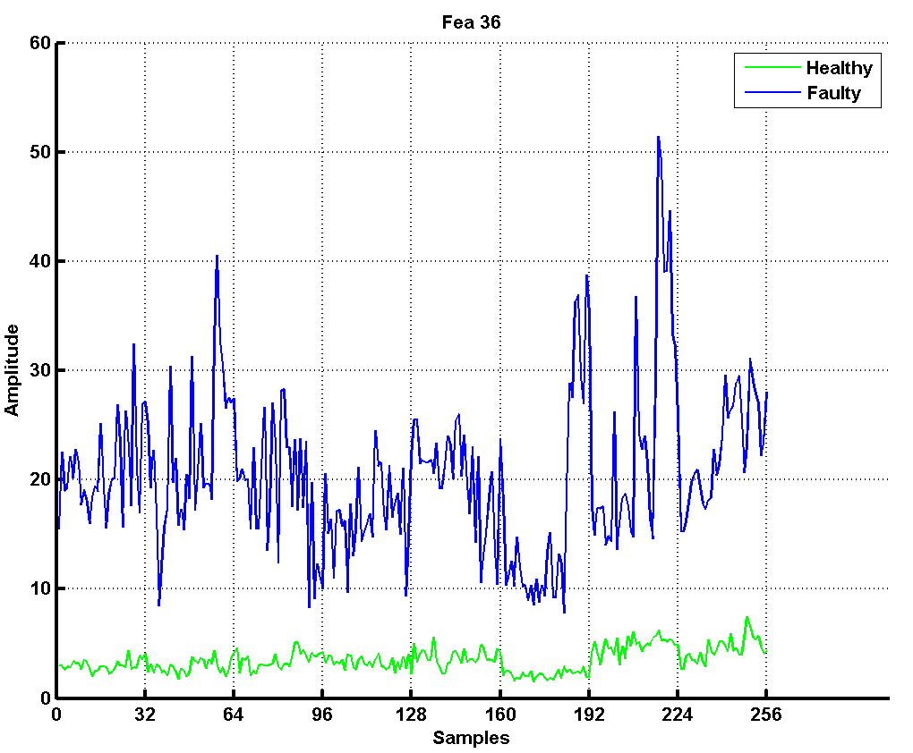
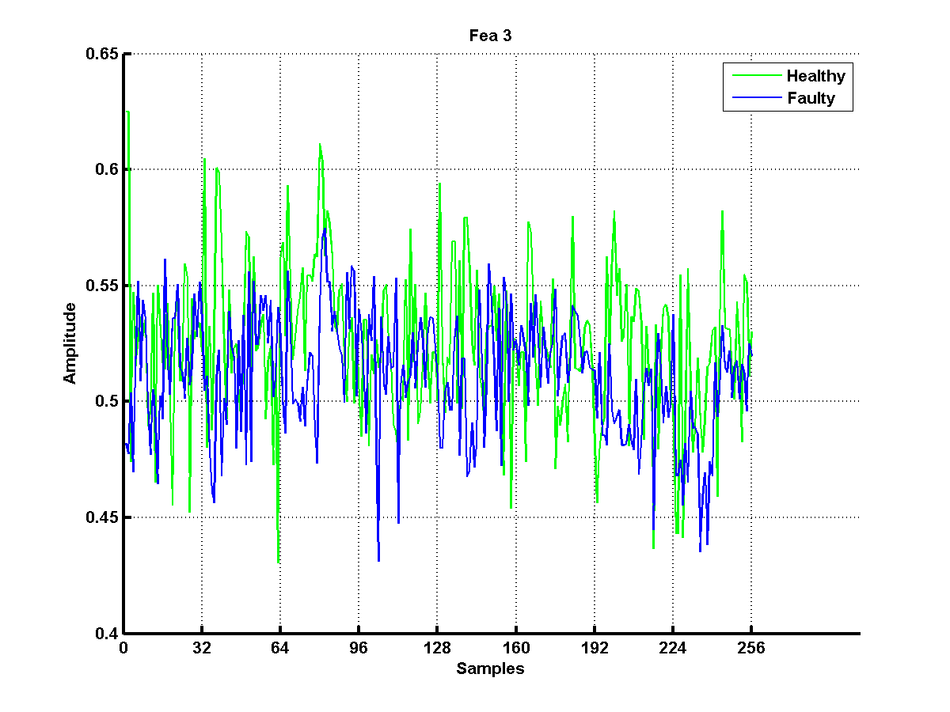


Good Feature vs. Bad feature : Visual Separation
Notes:
Notes:
We introduced this concept last year where we individually observed all feature plots and manually found the good features. This year we have automated this process.

Slide 7
Novel Feature Selection Technique
A new Feature Selection Method based on Visual Separation.
Features were plotted for two states (which are to be distinguished) for multiple datasets. The plots of all features were observed manually.
The plots where one could see the features distinguishing the two states consistently over most of the datasets, were selected. These selected features were later used for classification purposes.
Datasets where otherwise good features gave bad performance were considered as corrupt and were rejected in training phase.
These features gave much more consistent performance; thus showed better reliability. However the drawback was that the process of selecting features was manual; hence time consuming.

Slide 8
How to Automate This ?
For automating the feature selection process described in previous slide, following are needed.
Identification of Performance Parameters of Features: Need for defining parameters which depict the performance of features over prolonged time.
Estimating the Threshold of Parameters: Once parameters are defined, threshold values for the same need to be judged so as to filter out the bad features. This process of finding threshold values also needs to be automated.
Automatic Rejection of Dataset: Good features may get rejected due to corrupt datasets; hence automatic rejection of corrupt datasets (if any) is also needed.

Slide 9
Performance Parameters for Features:
Four parameters were identified to capture features’ ability to distinguish two states effectively and reliably.
Zero Crossing Rate
Separation Count
Ratio of Means
Standard Deviation of Means

Slide 10
Zero Crossing Rate (ZCR)
This is a measure of how many times the plot of healthy and faulty data intersect each other.
The difference of the two states’ plot is taken and the number of times this difference crosses zero value is termed as ZCR parameter.
Low ZCR implies a better feature.

Slide 11
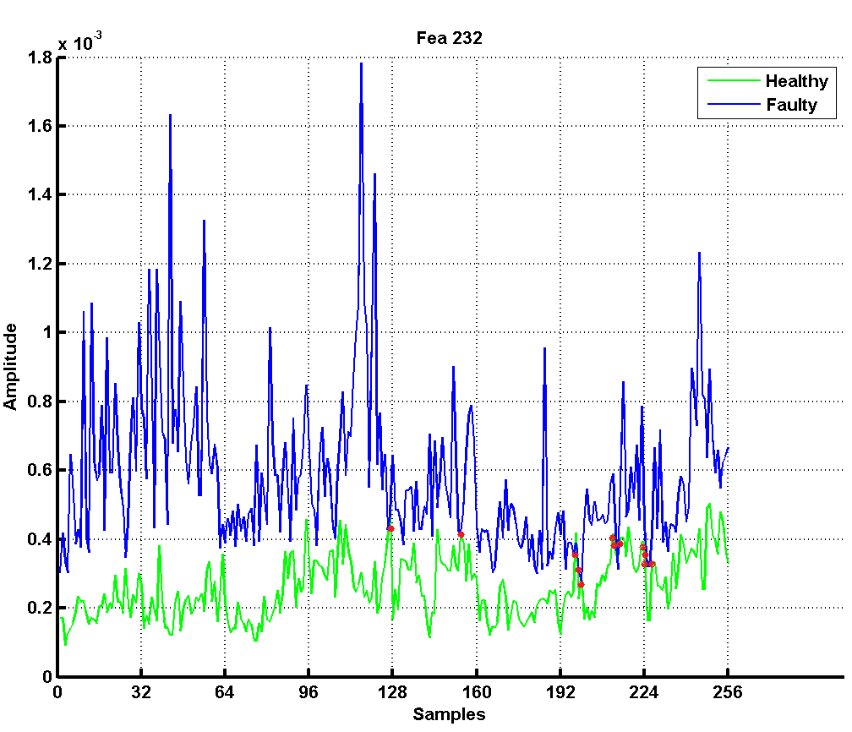
Zero Crossing Rate
Zero Crossing Rate value is 12

Slide 12
Separation Count
This measures the plot’s ability to have the two states separated by an imaginary line.
It counts the number of times that healthy and faulty plot cross the imaginary line of separation (i.e. maximum or minimum value of the data).
As shown in figure upper line indicates maximum of Faulty while lower line indicates minimum of Healthy data.
Low separation count implies a better feature.

Slide 13
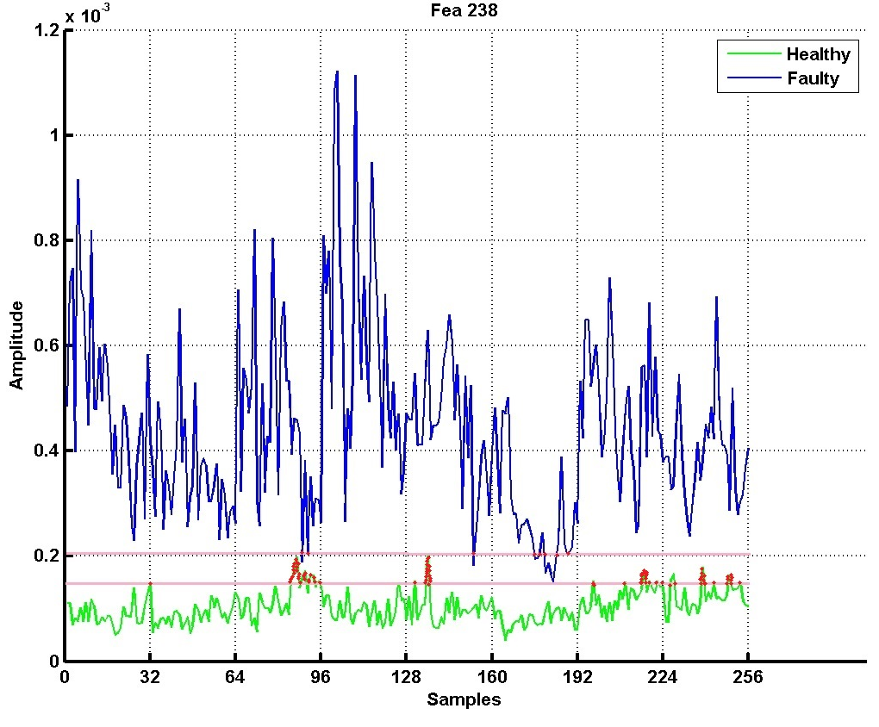
Separation Count
Separation Count: 65

Slide 14
Ratio of Means
Ratio implies the amount of uncertainty a faulty feature resembles its healthy counterpart.
It is the ratio of the mean of lower plot (here it is faulty) to mean of upper plot (here it is healthy) over all datasets.
Lower ratio implies better ability to distinguish; hence better feature.

Slide 15
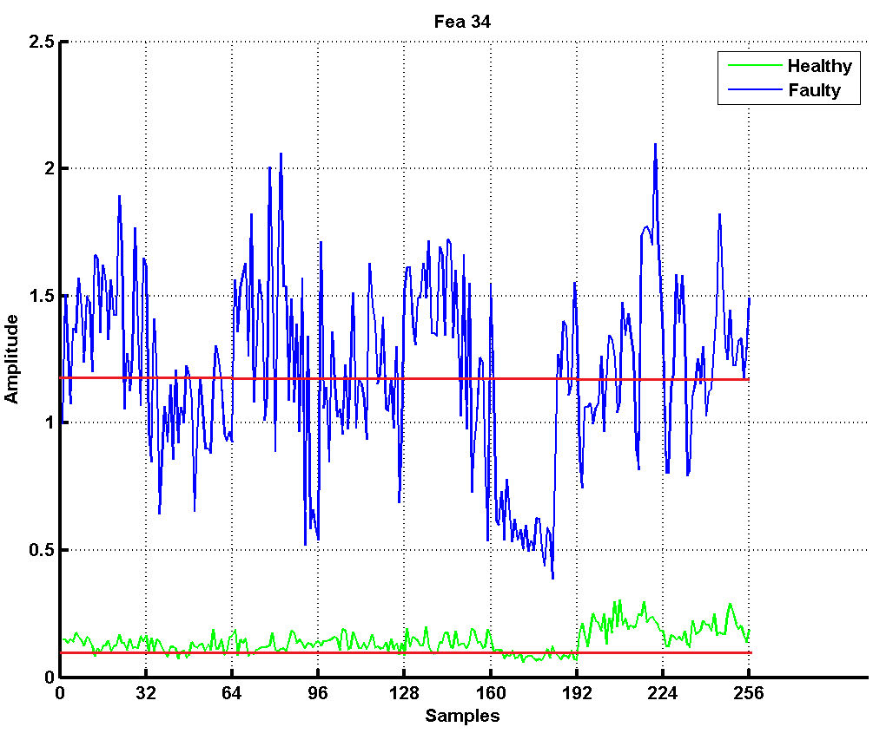
Ratio of Means
Mean of Faulty Datasets:1.1971
Mean of Healthy Datasets:0.1422
Ratio of Means: 0.118787

Slide 16
Standard Deviation of Means
This measures the variations caused in features due to abnormal changes in machine when run for prolonged time.
It computes the standard deviation of mean values of the plots divided into datasets of equal data width.
This is calculated after normalizing the feature values.
Low standard deviation of means implies better feature.

Slide 17
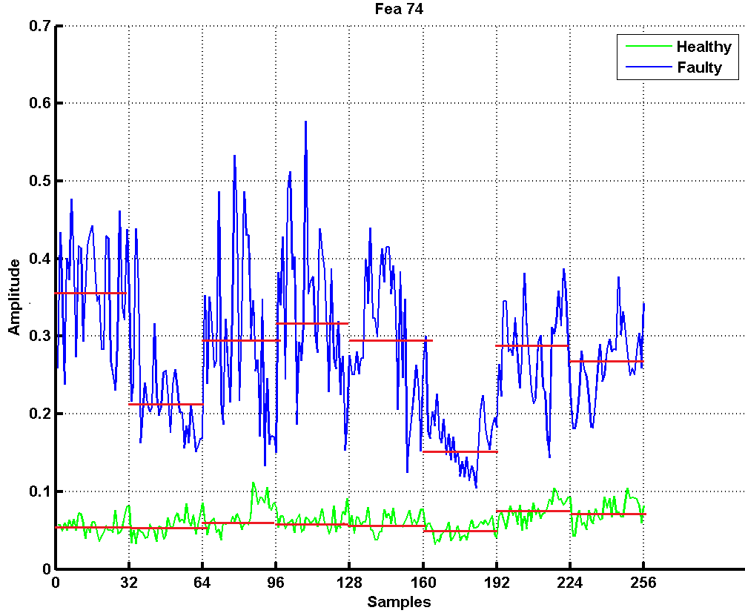
Standard Deviation of Means
Standard Dev. of Faulty Datasets: 0.0607
Standard Dev. of Healthy Datasets: 0.0093
Std. of Means : 0.118787 (Healthy Std. Dev. + Faulty Std. Dev.)

Slide 18
Automating Feature Selection ??
Separation Threshold??
ZCR Threshold??
Ratio Threshold??
Standard Mean Threshold??
USER

Slide 19
Need for Pressure Range
Pressure is measured in lbf/square inch also known as PSI (per square inch). In air compressor it has a major significance as it directly reflects the condition of machine. Apart from it it was found it also impacts the Fault Diagnosis.
In fault diagnosis during visual analysis of features it was found that the for acoustic dataset features and data both are merely show any variation as pressure range increases where as in case of vibration data acquisition features and data both show measurable changes as pressure range changes.
There were some specific pressure ranges where features were clearly able to distinguish for two different state of machine. Hence, it was required to identify these pressure range for correct identification of machine state.

Slide 20
Data Acquisition in Specific Pressure Range
In our experiment, we have used ELGI single stage air compressor where pressure range varies from.
For experimentation purpose we have used only following
2-4 PSI
4-6 PSI
6-8 PSI
8-10 PSI
In case of Healthy- LIV fault analysis for vibration data we found that pressure range 4-6 was more sensitive to the fault.
In case of Healthy-LOV analysis for vibration data it was found that pressure range 6-8 was more sensitive.

Slide 21
Find Pressure Range. (For ex. feature matrix 576*286 size)
Arrange given feature matrix in such a way that each pressure range is now treated as a new feature. Hence, no. of features will be increases now there will be (features* Pressure Ranges) features. (72*286)*4
Estimate the size of datasets, features and data width. (features=286,dataset=9)
Initialize Score Array with 1 (4*286)and Average Array (4*4) with 0 which keep counts of score of selected features and average values of the four parameters respectively for each pressure range.
for n=1: Num_PressureRanges
Find good features (kept in allScoreArray) and good datasets (all_ healthy=56*286, 72*586,72*586,72*586)
It gives average parameter matrix (thresh_zcr,thresh_separation,thresh_ratio,thresh_std) (allAverageArray) for all pressure ranges.
Now, calculate average for the four parameter (kept in allAverageArray) only for above selected features.
Now, using above mentioned matrix the ranks are set to each pressure range, then overall ranking of pressure range is estimated.
The pressure range having lowest rank is marked as the most sensitive pressure range.

Slide 22
Feature Selection Algorithm’s Concept
Good features should have lower values for the four thresholds mentioned.
Lower the threshold values, better is the feature.
Thus, every feature can be assigned a rank based on their threshold values.
Lower the total sum of four ranks for each feature, better the feature.

Slide 23
Feature Selection Algorithm Implementation
Find the four parameters’ value for each feature and store them in four separate arrays.
Sort the four arrays and rank the features based on ascending order of threshold value.
Sum up the four ranks for each feature and sort the features based on this sum of ranks.
The best features are in front of the sorted array.

Slide 24
ZCR AVERAGE
ZCR RANK MATRIX
F1
SEPARATION AVG
RATIO AVG
STD_MEAN AVG
ZCR AVERAGE
SEPARATION RANK MATRIX
F2
SEPARATION AVG
RATIO AVG
OVERALL RANK
STD_MEAN AVG
Sum all the ranks for individual feature to get overall rank
ZCR AVERAGE
RATIO RANK MATRIX
F3
SEPARATION AVG
.
.
.
.
.
RATIO AVG
STD_MEAN AVG
ZCR AVERAGE
STD_MEAN RANK MATRIX
F286
SEPARATION AVG
RATIO AVG
Ranks are assigned by sorting average values in ascending order
STD_MEAN AVG

Slide 25
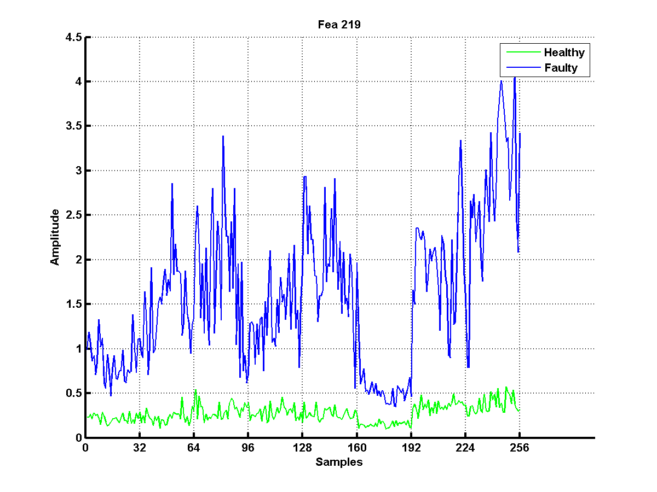
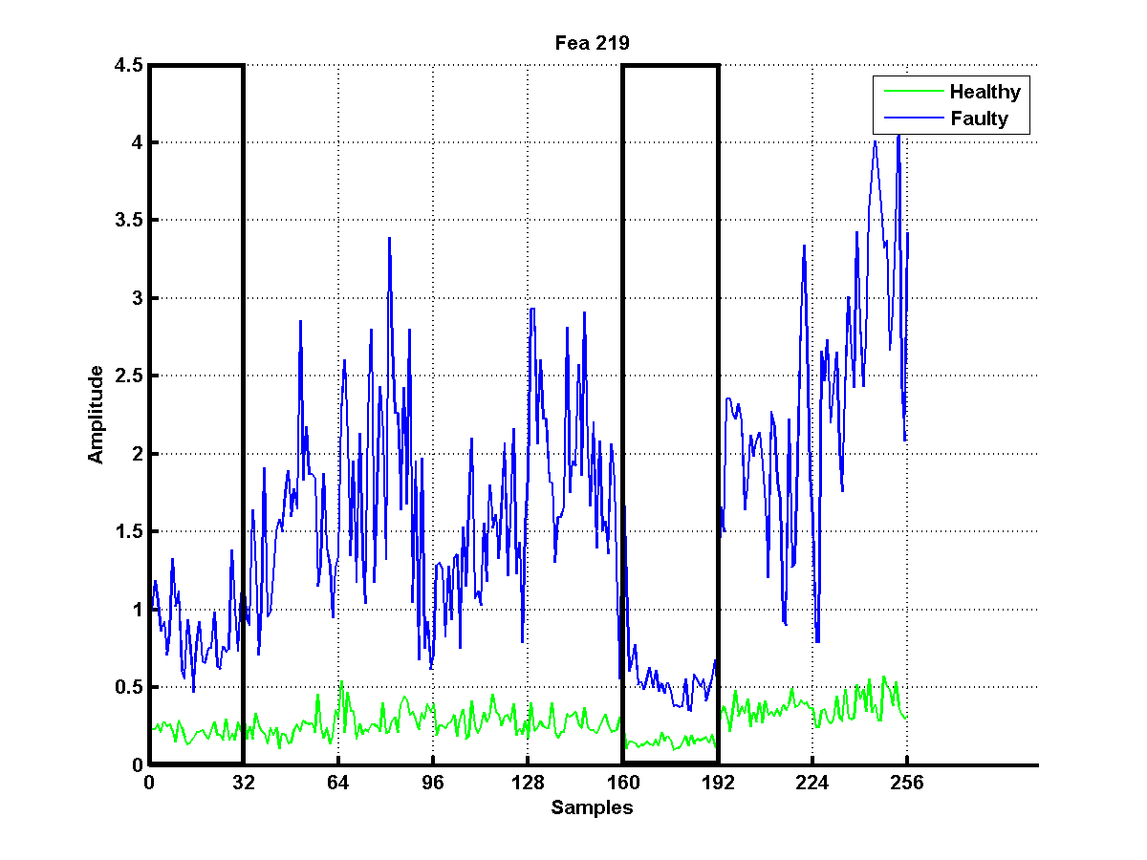
Removal of Corrupt Dataset
Not all datasets need to be considered while finding the best features.
Corrupt dataset can make a feature bad.
Thus, along with selection of good features, the datasets on which these features are based must also be good and consistent .

Slide 26
What to do First Select Good Features or Reject Corrupt Dataset?
Good features may get rejected due to corrupt dataset.
Good dataset also may seem corrupted due to bad features.
Thus, both dataset rejection and feature selection need to go on simultaneously to give the best features based on consistent datasets.

Slide 27
Dataset Rejection Algorithm Implementation
Dataset rejection is based on the four thresholds found only for good features.
A dataset is considered for rejection when
It contributes to more than 80% of total ZCR value.
It has average ZCR, separation and ratio more than corresponding threshold values.
A dataset is rejected if more than half of the good features suggest it to be rejected.

Slide 28
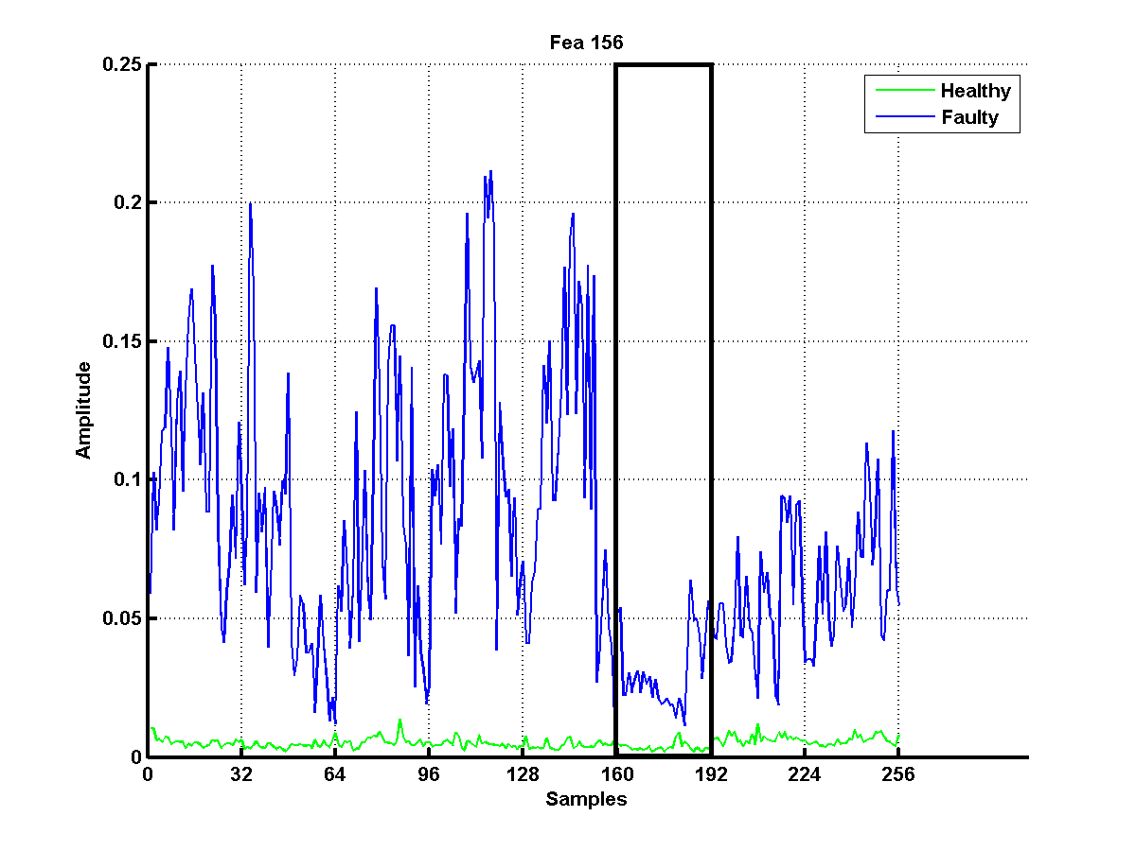
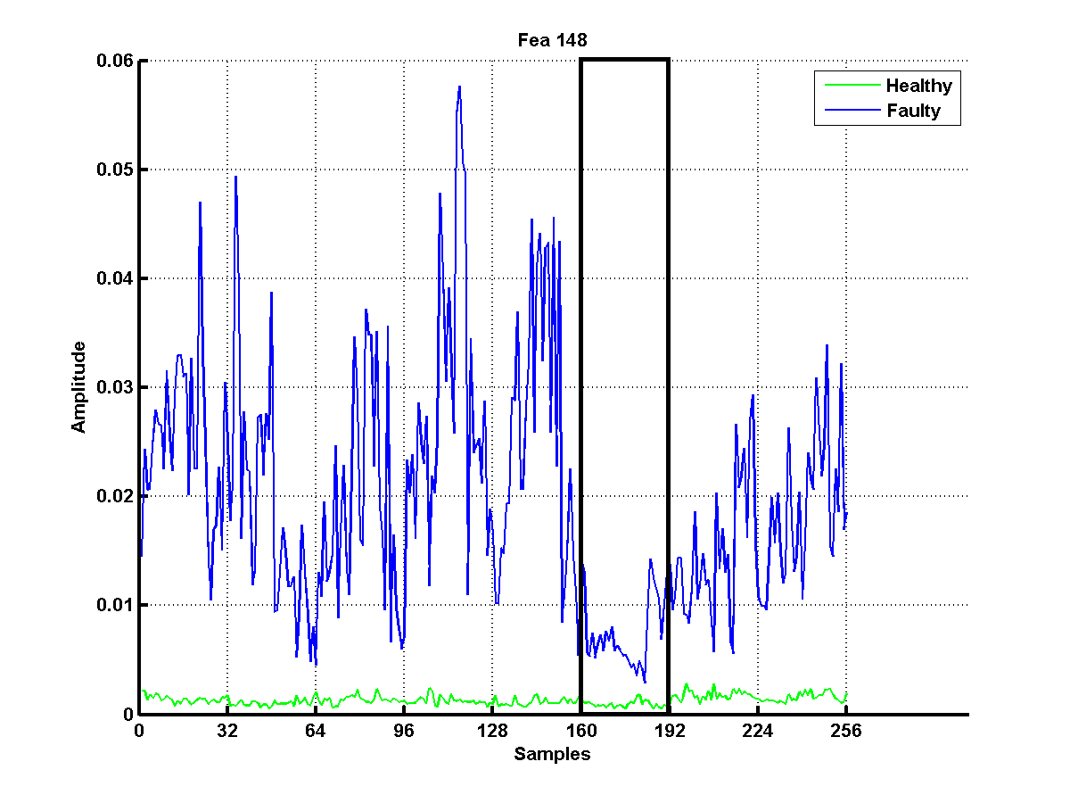
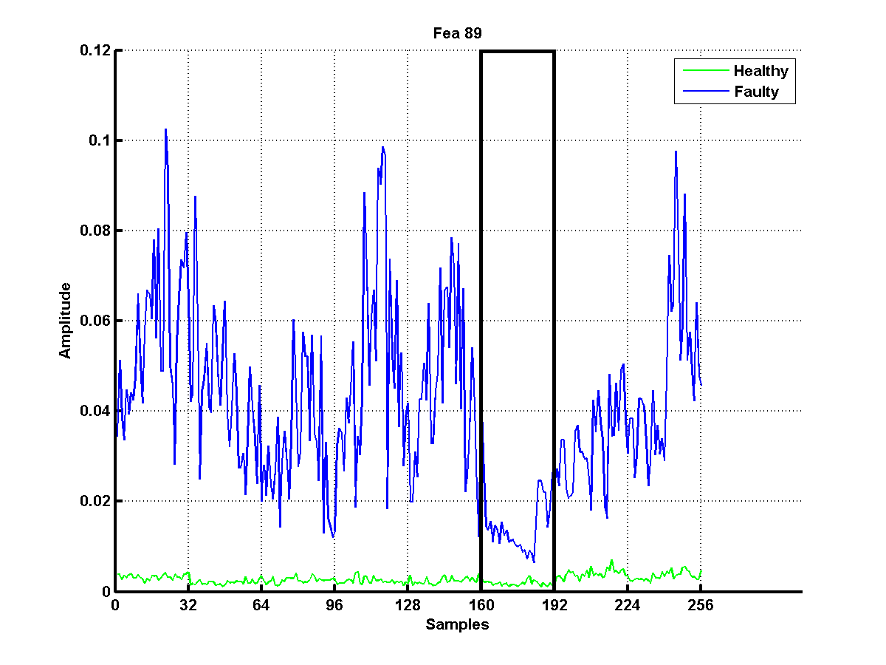
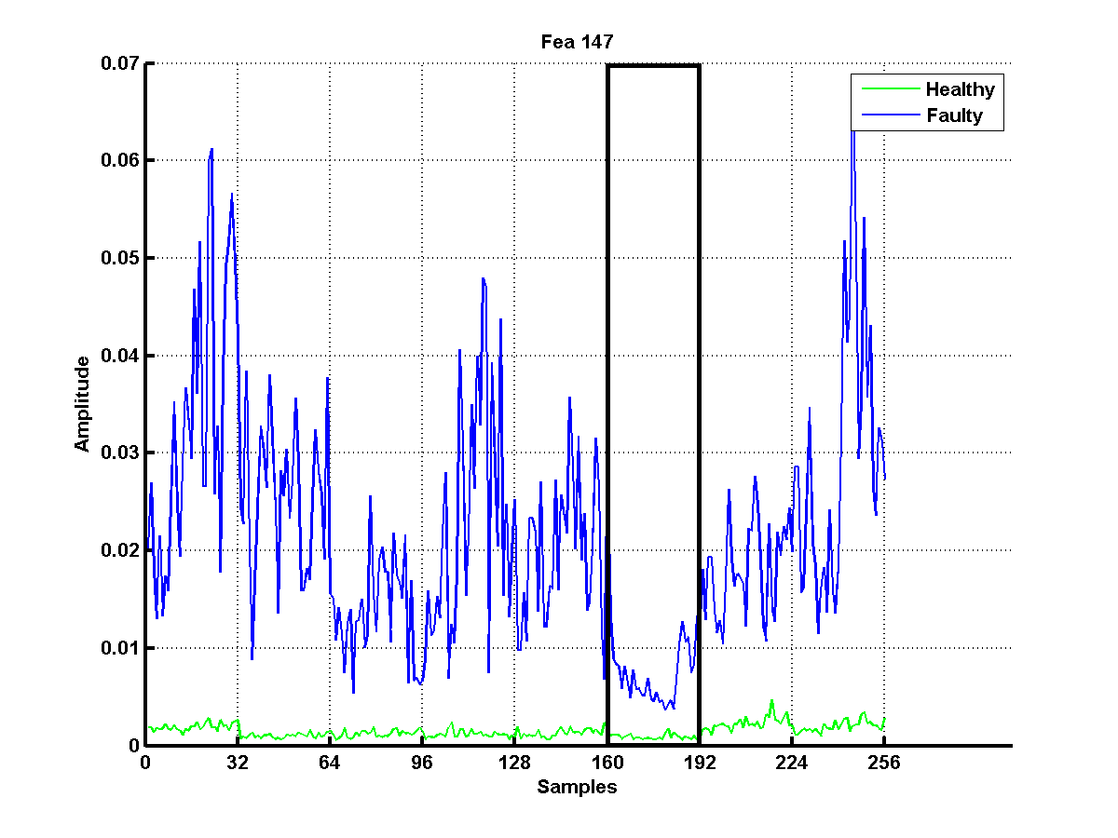
All these features suggest that dataset 6 needs to be rejected. So it is rejected.

Slide 29
Algorithm having simultaneous Dataset Rejection and Feature Selection
To consider simultaneous dataset rejection and feature selection, a loop is constructed to execute till number of good features is less than the required number of features.
Inside the loop, average parameter values of all datasets is calculated only for the good features present at that stage which then determine if any dataset is to be rejected. In the beginning, all features are considered as good features. It should be noted that in one loop, only one dataset is rejected.
Based on non corrupt datasets (after rejection), half the number of total features are selected as good features. With every iteration, based on four parameter averages of all datasets for good features, corrupt datasets if present, gets rejected. It must be noted that there is a maximum limit (given by user) till which datasets that are allowed to be rejected.
This process of rejection and selection continues till the count of good features goes lower than the required number of good features.

Slide 30
Feature Selection Flow Chart
Extracted Features
No. of good features < Required features
Update the number of good features to half its previous value
True
Output the selected features
False
Calculate average for the four parameter thresholds (only for good features)
Reject corrupt dataset if any based on these four average values
Use Feature ranking algorithm to select the best half of the good features

Slide 31
Dependencies
The algorithm needs the following parameters
Two feature matrices, one for each healthy (state 1) and faulty state (state 2), with number of rows equal to the number of samples i.e. (number of datasets x number of recordings in each dataset) and number of columns equal to total number of features.
Number of datasets. This is needed for judging the sample width (number of samples) of each dataset
Number of datasets that can be rejected at max.
Number of good features desired (default is 30).

Slide 32
Shortcomings of the Algorithm
Equal weightage is given to all the four parameters for judging the good features which may not always be true.
The user needs to decide how many datasets can be rejected.
The algorithm does not return desired number of good features, instead it is a number that is always lower than desired number.

Slide 33
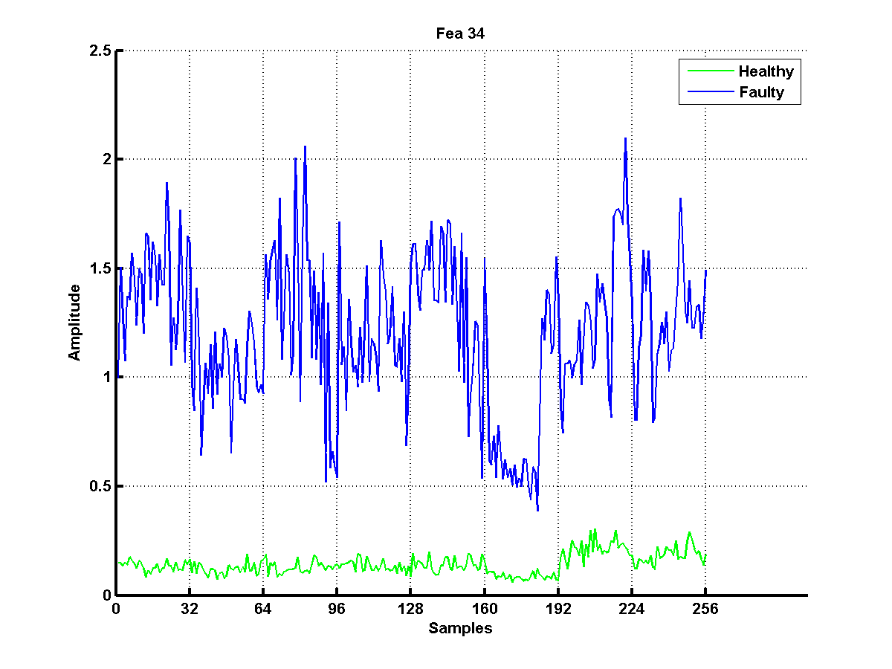
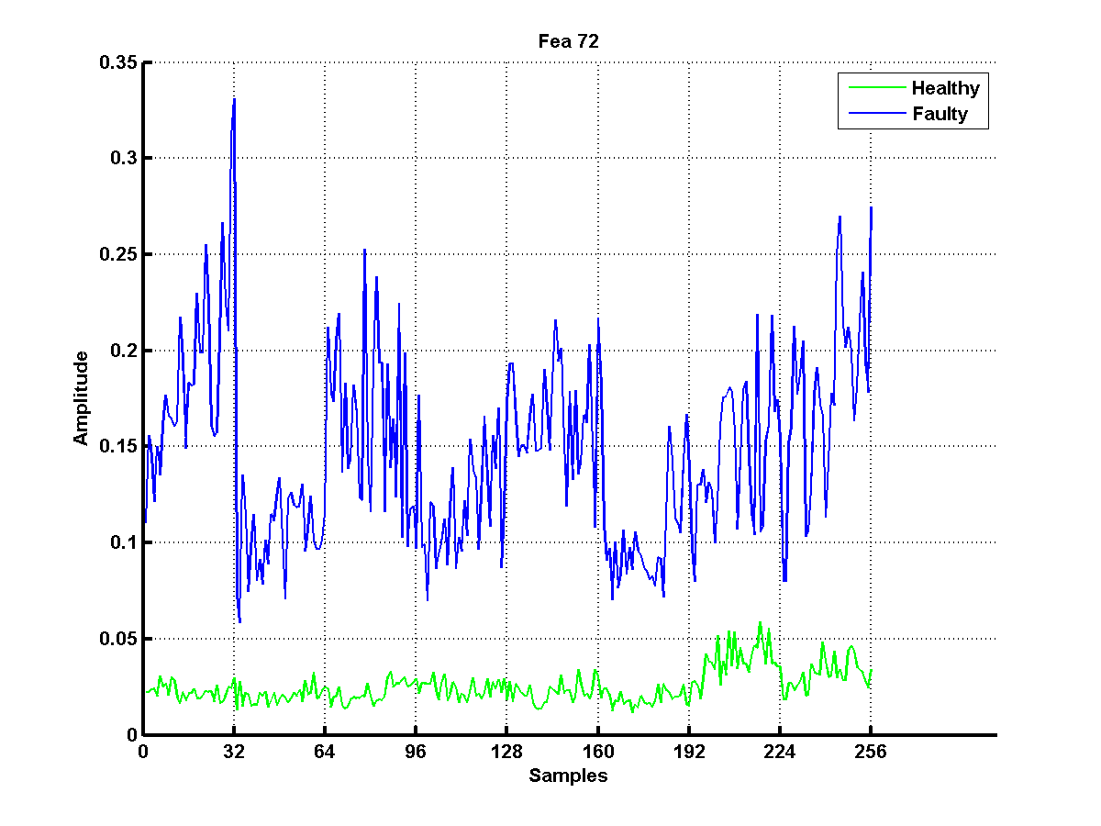
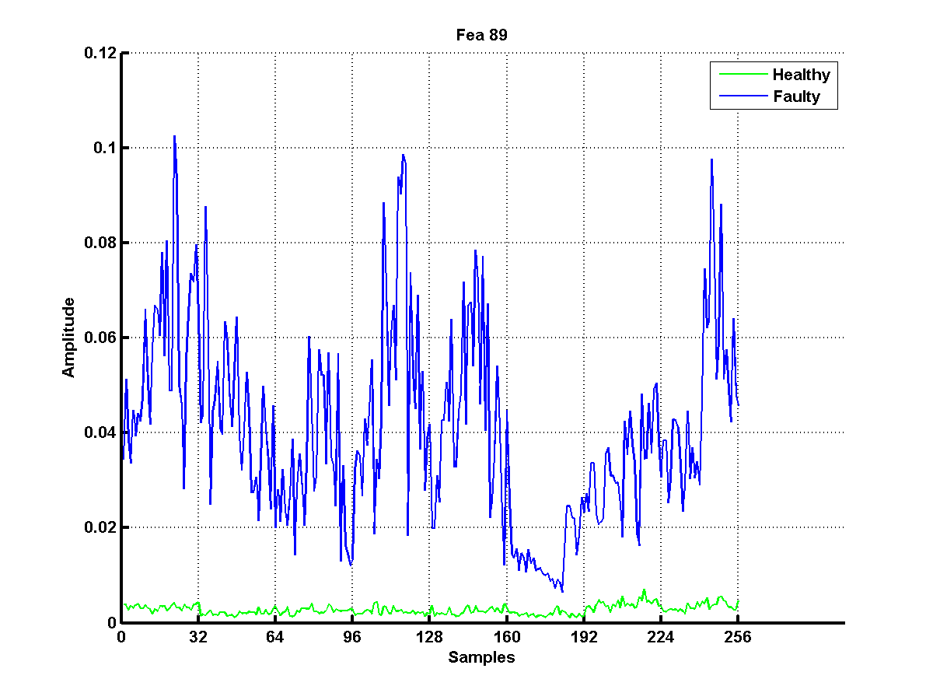
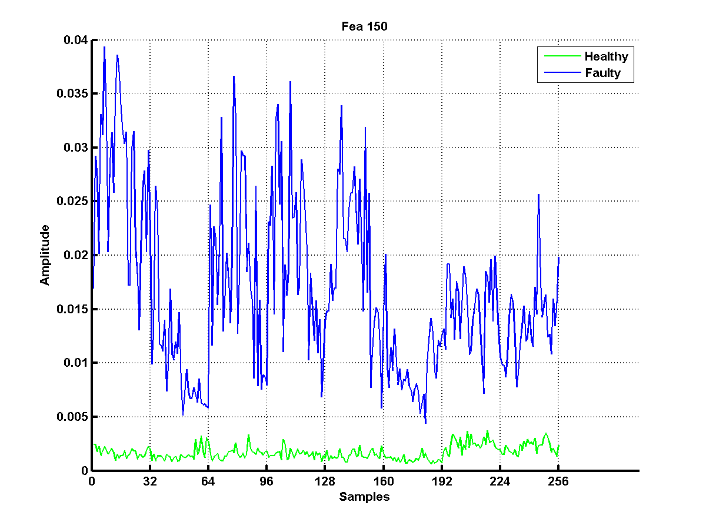
Results – Good Features found by Algorithm

Slide 34
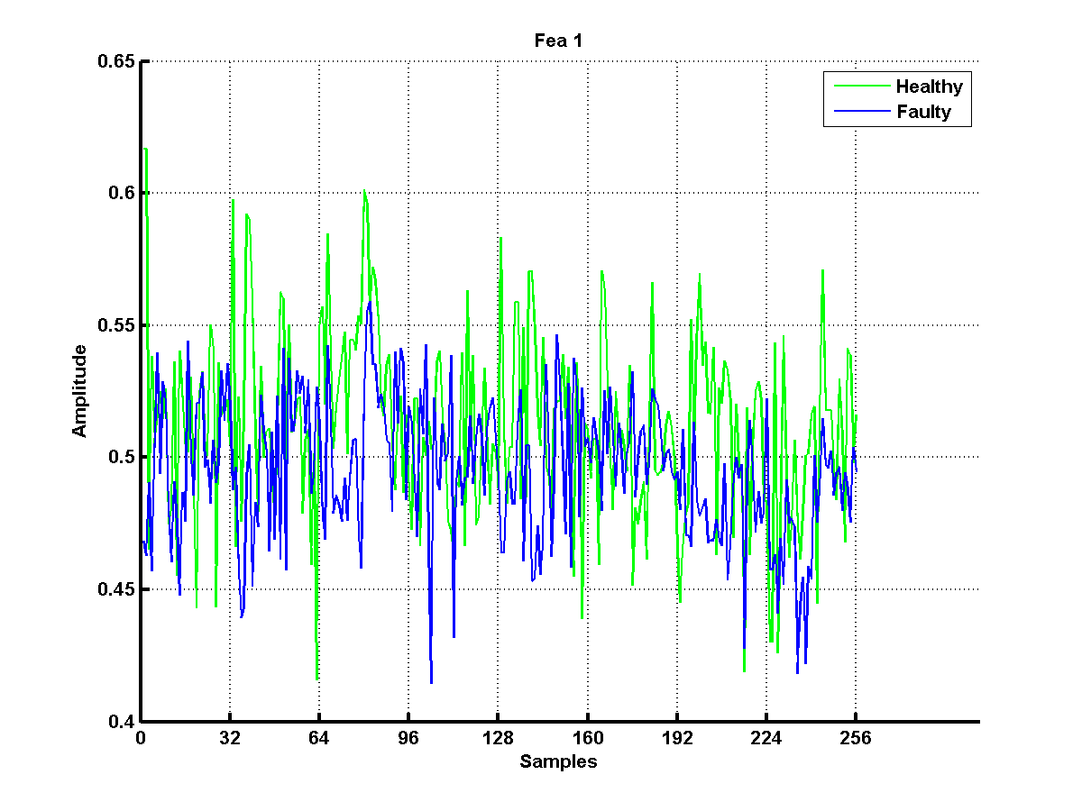
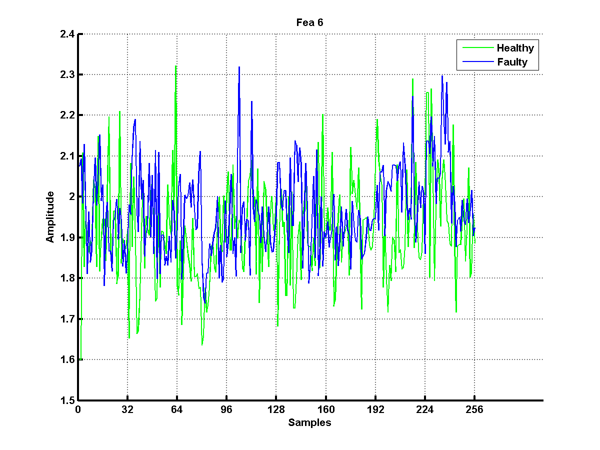
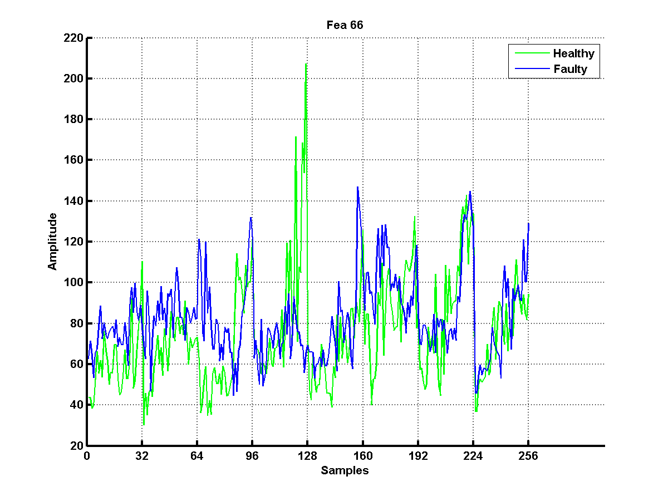
Results - Bad Features found by Algorithm

Slide 35
Feature Selection Algorithm’s Concept
Good features should have lower values for the four thresholds mentioned.
Lower the threshold values, better is the feature.
Thus, every feature can be assigned a rank for each threshold value.
Lower the total sum of four ranks for each feature, better the feature.
35

Slide 36
Feature Selection Algorithm Implementation
Find the four parameters’ value for each feature and store them in four separate arrays.
Sort the four arrays and rank the features based on ascending order of threshold value.
Sum up the four ranks for each feature and sort the features based on this sum of ranks.
The best features are in front of the sorted array.
36

Slide 37
ZCR AVERAGE
ZCR RANK MATRIX
F1
SEPARATION AVG
RATIO AVG
STD_MEAN AVG
ZCR AVERAGE
SEPARATION RANK MATRIX
F2
SEPARATION AVG
RATIO AVG
OVERALL RANK
STD_MEAN AVG
Sum all the ranks for individual feature to get overall rank
ZCR AVERAGE
RATIO RANK MATRIX
F3
SEPARATION AVG
.
.
.
.
RATIO AVG
STD_MEAN AVG
ZCR AVERAGE
STD_MEAN RANK MATRIX
F286
SEPARATION AVG
RATIO AVG
Ranks are assigned by sorting average values in ascending order
STD_MEAN AVG

Slide 38
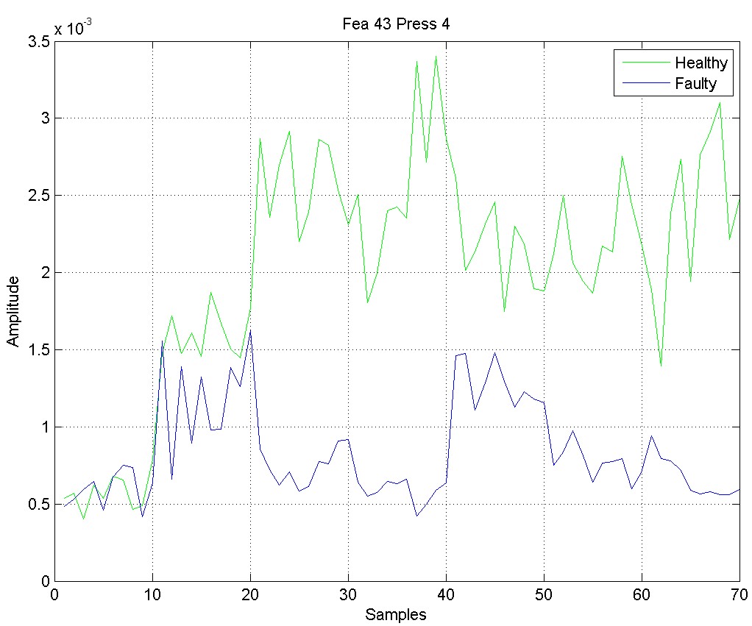
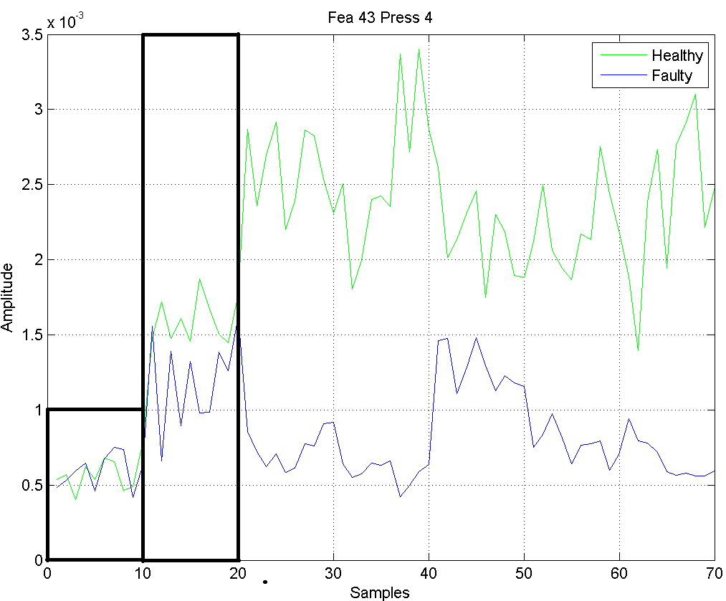
Need for Dataset Rejection
Not all datasets need to be considered while finding the best features.
Corrupt dataset can make a feature bad.
Thus, along with selection of good features, the datasets on which these features are based must also be good and consistent .
38

Slide 39
What to do First Select Good Features or Reject Corrupt Dataset?
Good features may get rejected due to corrupt dataset.
Good dataset also may seem corrupted due to bad features.
Thus, both dataset rejection and feature selection need to go on simultaneously to give the best features based on consistent datasets.

Slide 40
Dataset Rejection Algorithm Implementation
Dataset rejection is based on the four thresholds found only for good features.
A dataset is considered for rejection when
It contributes to more than 80% of total ZCR value.
It has average ZCR, separation and ratio more than corresponding threshold values.
A dataset is rejected if more than half of the good features suggest it to be rejected.
40

Slide 41
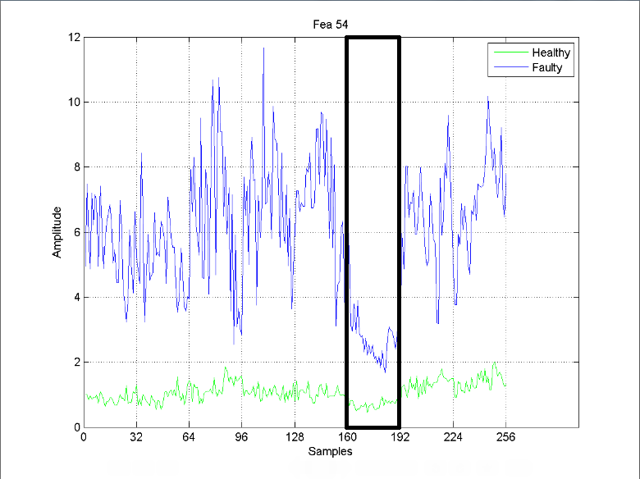
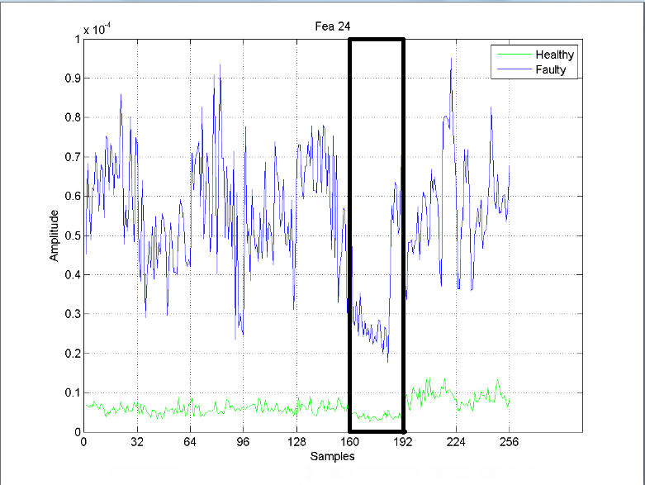
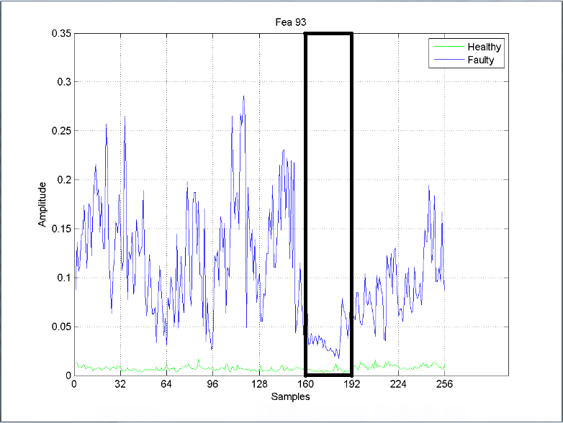
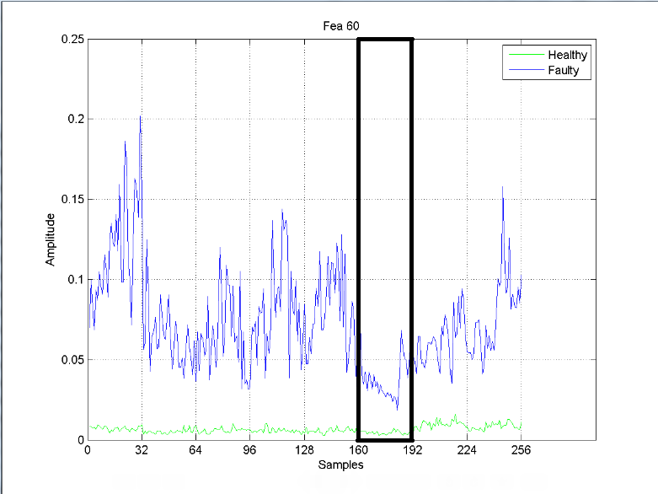
All these features suggest that dataset 6 needs to be rejected. So it is rejected.

Slide 42
Algorithm having simultaneous Dataset Rejection and Feature Selection
To consider simultaneous dataset rejection and feature selection, a loop is constructed to execute till number of good features is less than the required number of features.
Inside the loop, average parameter values of all datasets is calculated only for the good features present at that stage which then determine if any dataset is to be rejected. In the beginning, all features are considered as good features. It should be noted that in one loop, only one dataset is rejected.
Based on non corrupt datasets (after rejection), half the number of total features are selected as good features. With every iteration, based on four parameter averages of all datasets for good features, corrupt datasets if present, gets rejected. It must be noted that there is a maximum limit (given by user) till which datasets that are allowed to be rejected.
This process of rejection and selection continues till the count of good features goes lower than the required number of good features.
42

Slide 43
Feature Selection Flow Chart
Extracted Features
No. of good features < Required features
Update the number of good features to half its previous value
True
Output the selected features
False
Calculate average for the four parameter thresholds (only for good features)
Reject corrupt dataset if any based on these four average values
Use Feature ranking algorithm to select the best half of the good features

Slide 44
Dependencies
The algorithm needs the following parameters
Two feature matrices, one for each healthy (state 1) and faulty state (state 2), with number of rows equal to the number of samples i.e. (number of datasets x number of recordings in each dataset) and number of columns equal to total number of features.
Number of datasets. This is needed for judging the sample width (number of samples) of each dataset
Number of datasets that can be rejected at max.
Number of good features desired (default is 30).
44

Slide 45
Shortcomings of the Algorithm
Equal weightage is given to all the four parameters for judging the good features which may not always be true.
The user needs to decide how many datasets can be rejected.
The algorithm does not return desired number of good features, instead it is a number that is always lower than desired number.
45

Slide 46
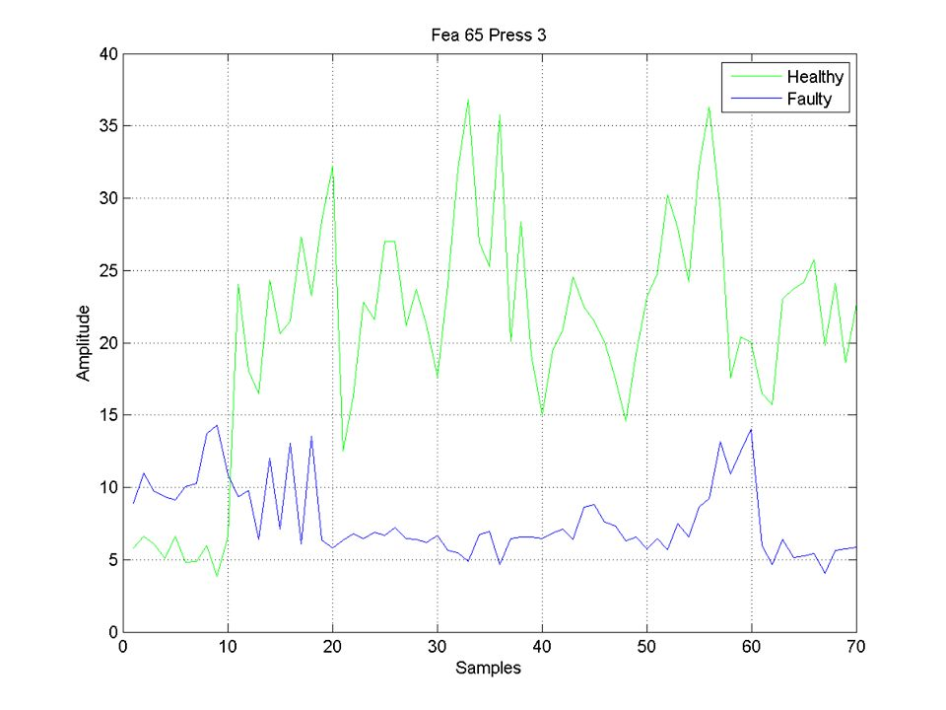
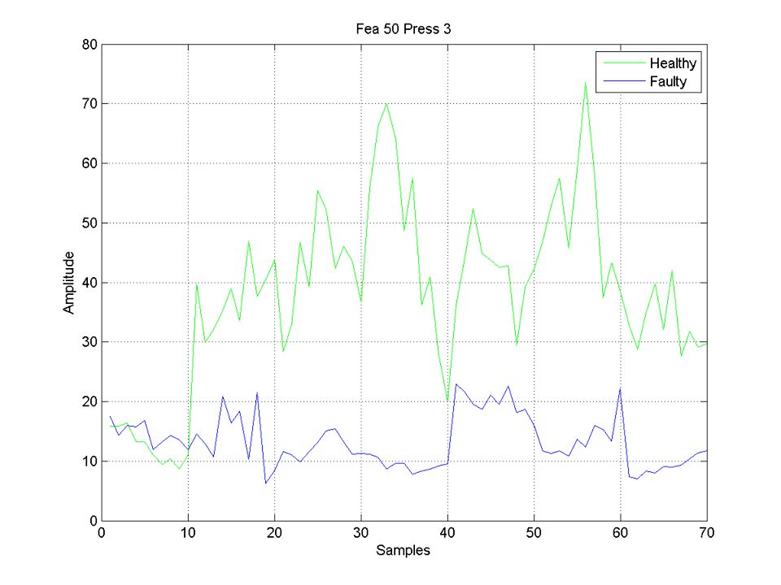
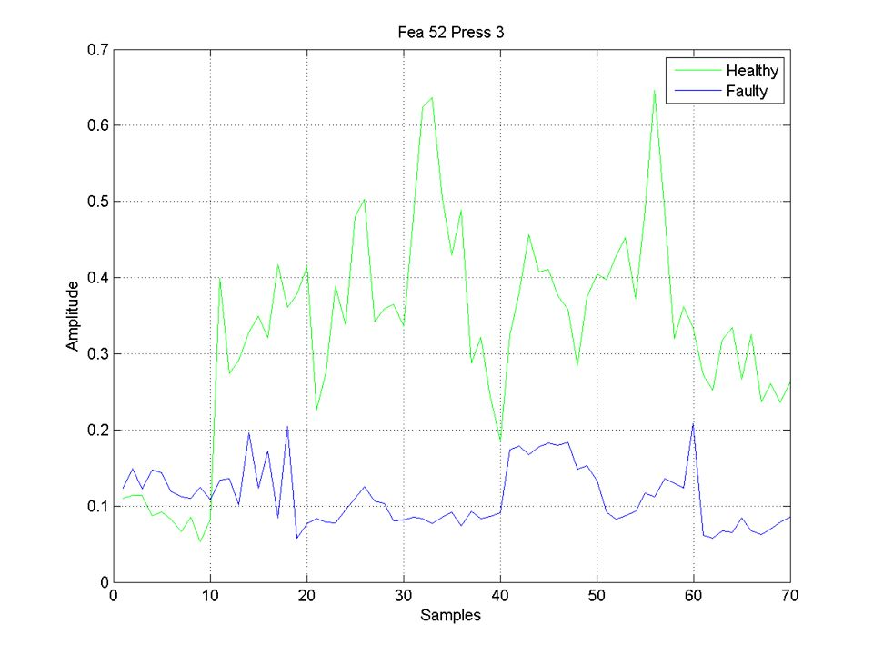
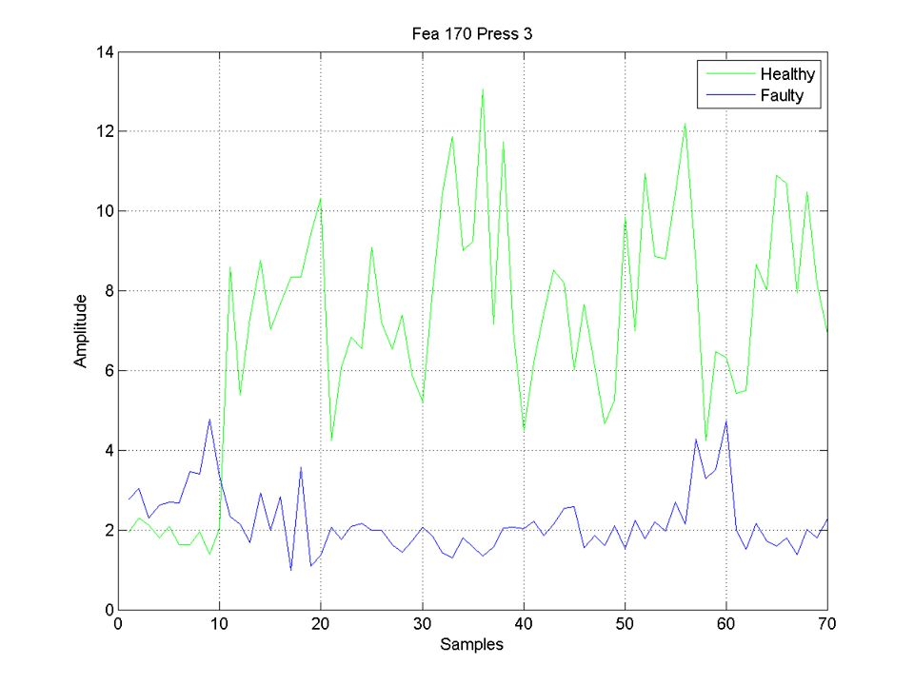
Results – Good Features found by Algorithm

Slide 47
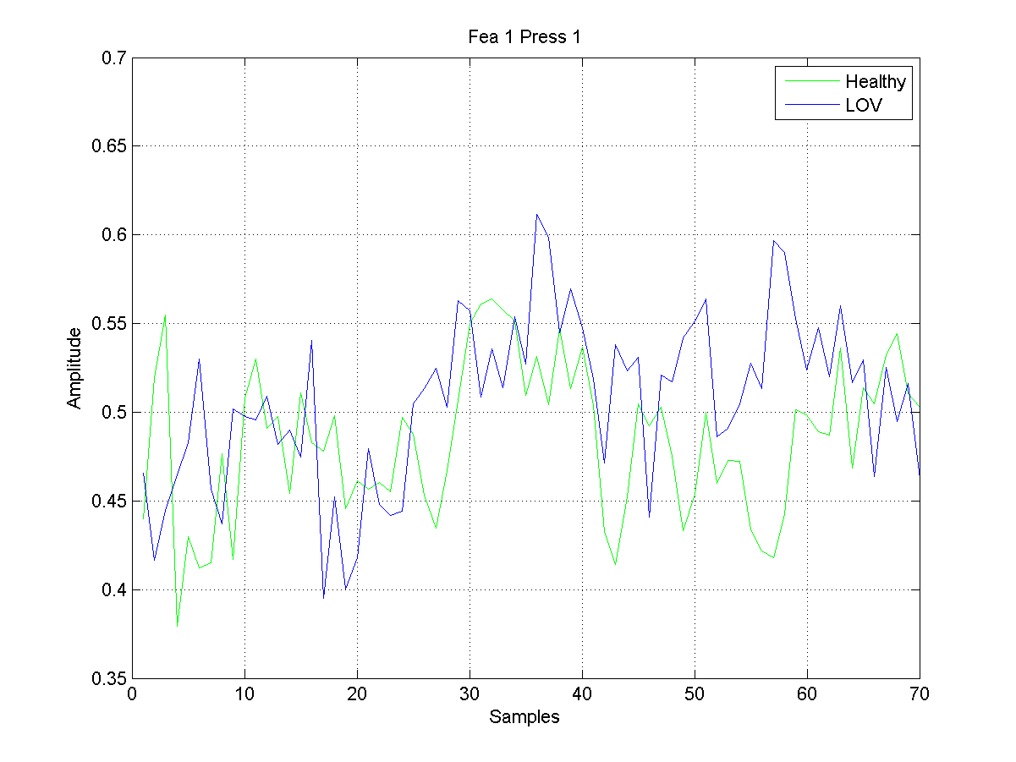
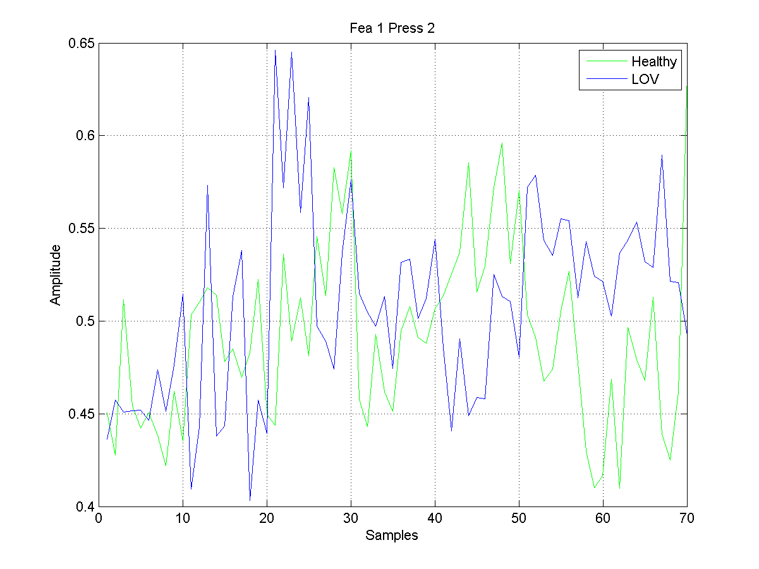
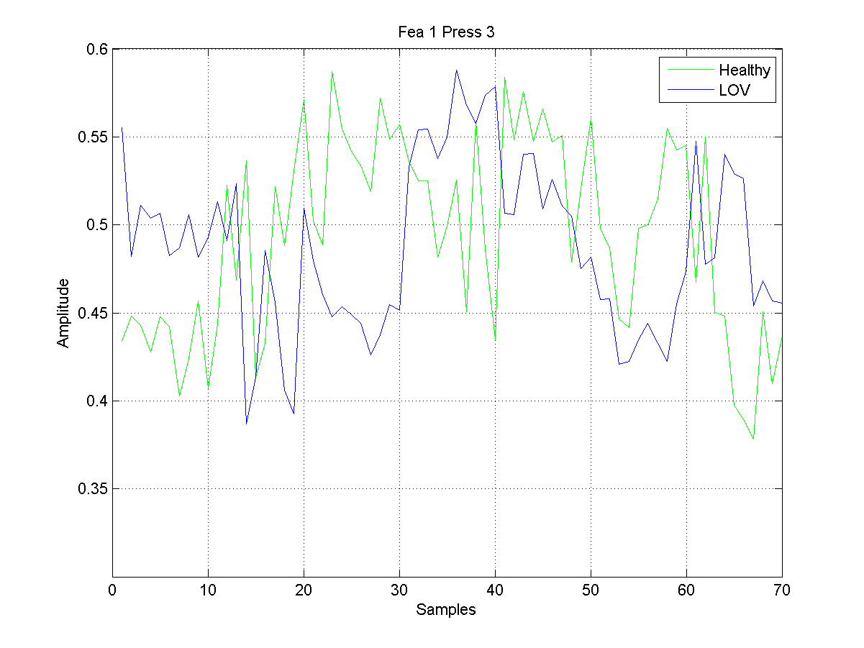
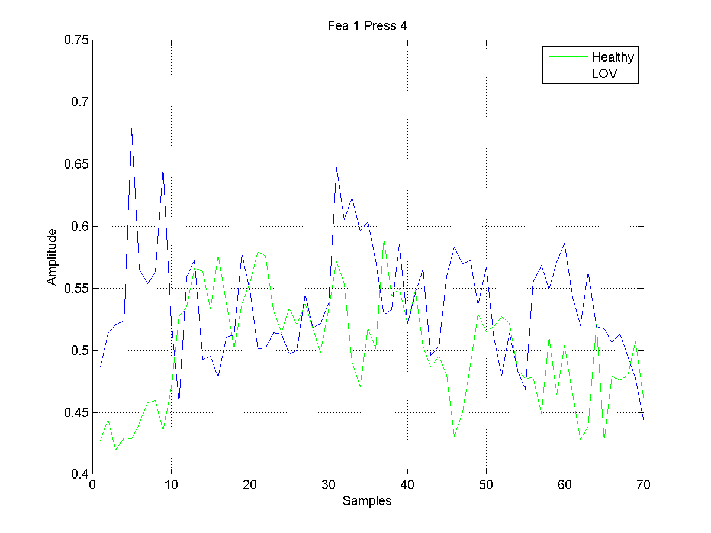
Results - Bad Features found by Algorithm

